Slide 1
Indoor Routing in Three Dimensional Spaces (Case Study: Telkom University, Bandung)
Tiara Annisa Dionti (1103134405)

Slide 2
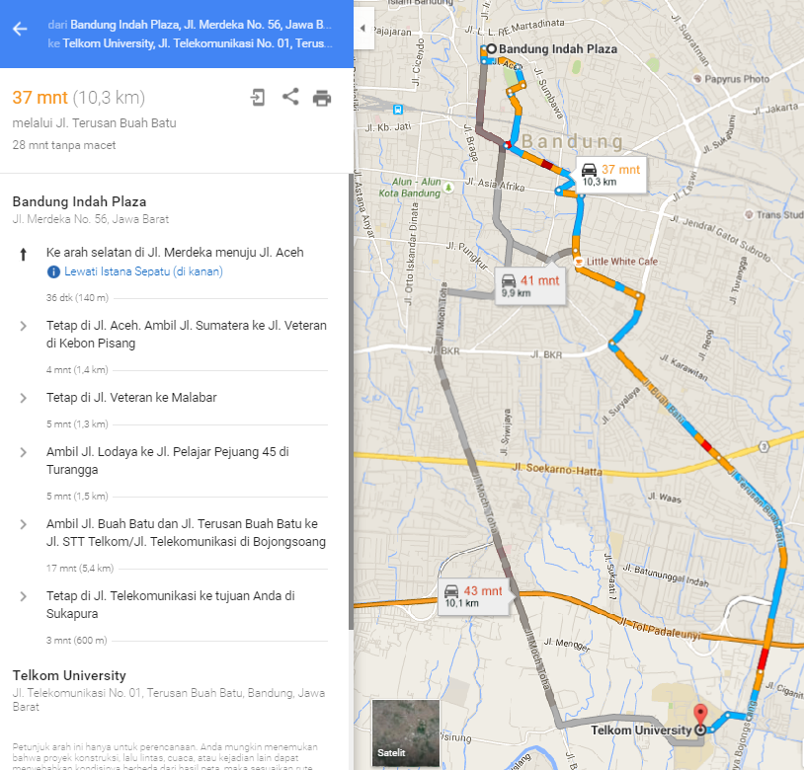
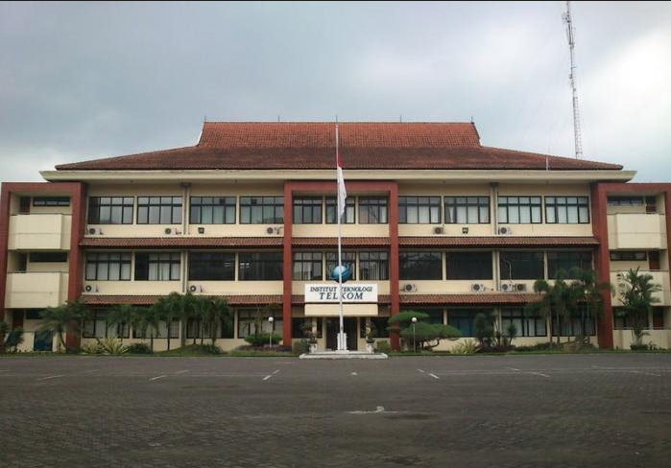
Introduction
MULTI-LAYERED
NO GPS
3D
?
2D
GPS
outdoor routing
How about indoor routing?

Slide 3

Objective
Modeling the 3D coordinates of multi-floored building.
Plotting the coordinates that derived from the earth coordinates.
Implementing the road network algorithm in 3D model.
Analyzing the performance of road network algorithm in 3D model.

Slide 4
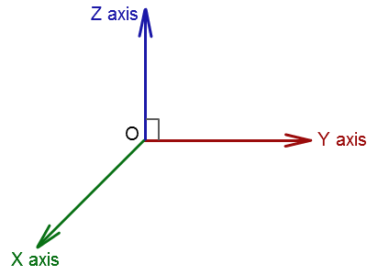
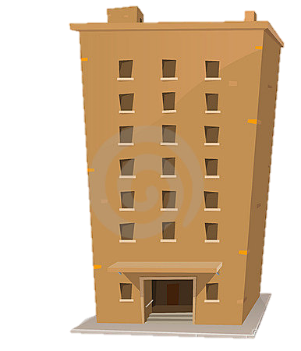
Three Dimensional Spaces
= Heigh / Floor Level ( Ordinal )
= Latitude ( Decimal )
= Longitude ( Decimal )

Slide 5
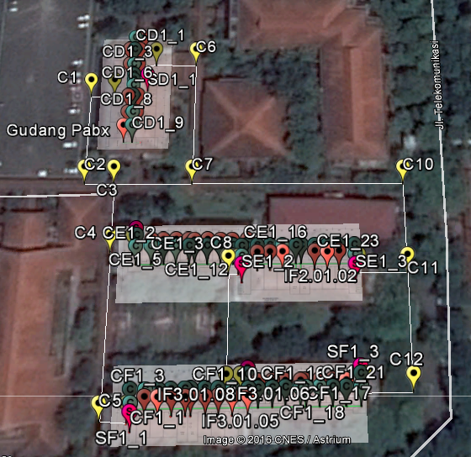
three dimensional spaces Structure
CHECK
THE MAP

Slide 6
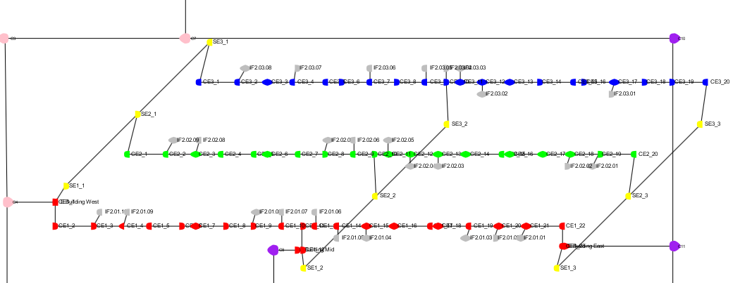
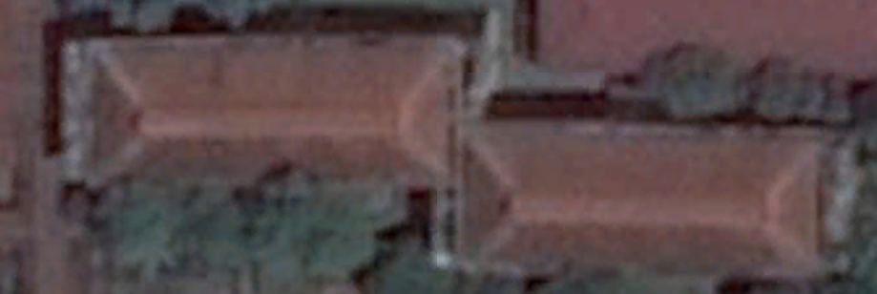
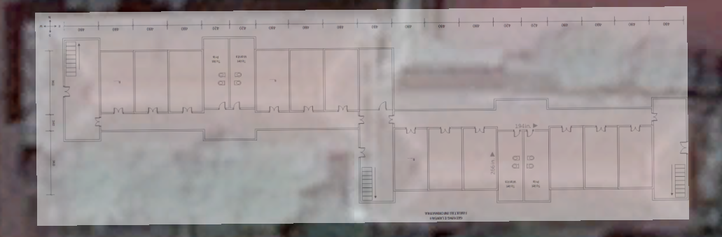
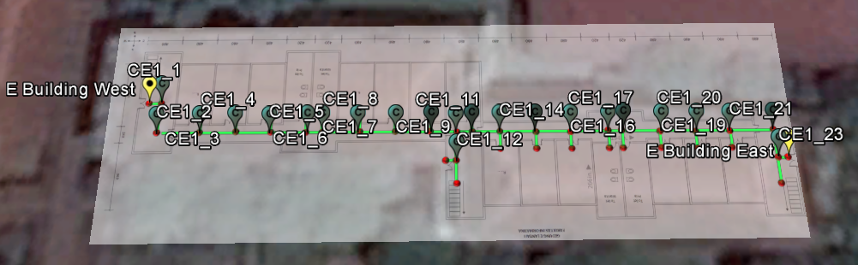
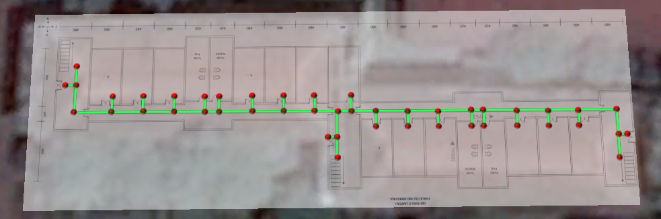
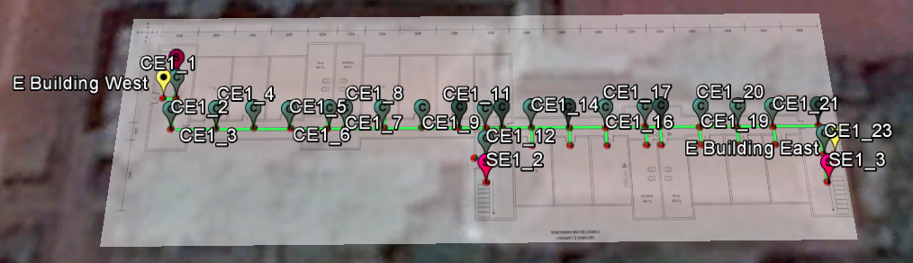
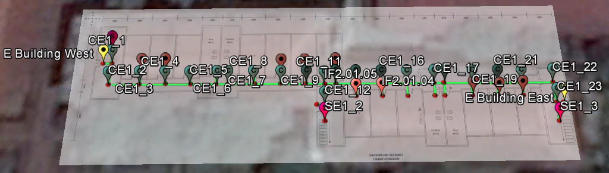
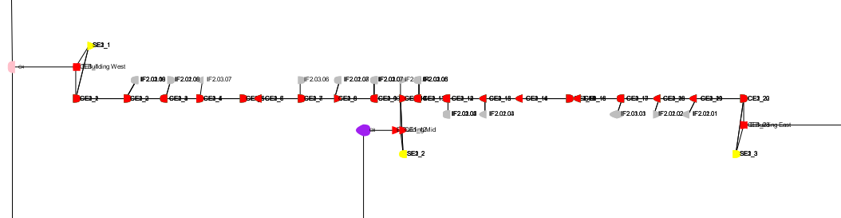
exaMPLE : e BUILDING

Slide 7
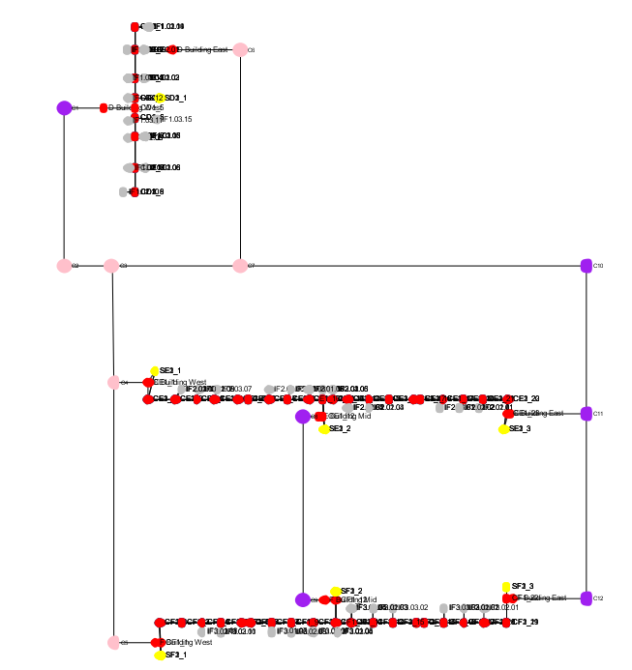
three dimensional spaces Structure

Slide 8
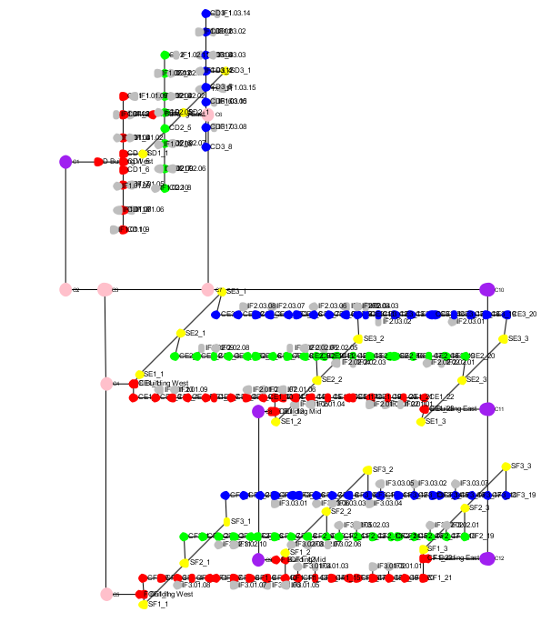
three dimensional spaces Structure
= 1st floor ( Z = 1 )
= 2nd floor ( Z = 2 )
= 3rd floor ( Z = 3 )
= stair
= room
= open outer corridor
= close outer corridor

Slide 9
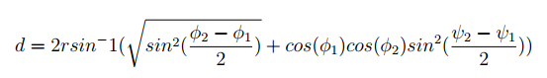
distance between two points using haversine formula
d = distance between two points
ψ = longitude φ = latitude
Reference

Slide 10
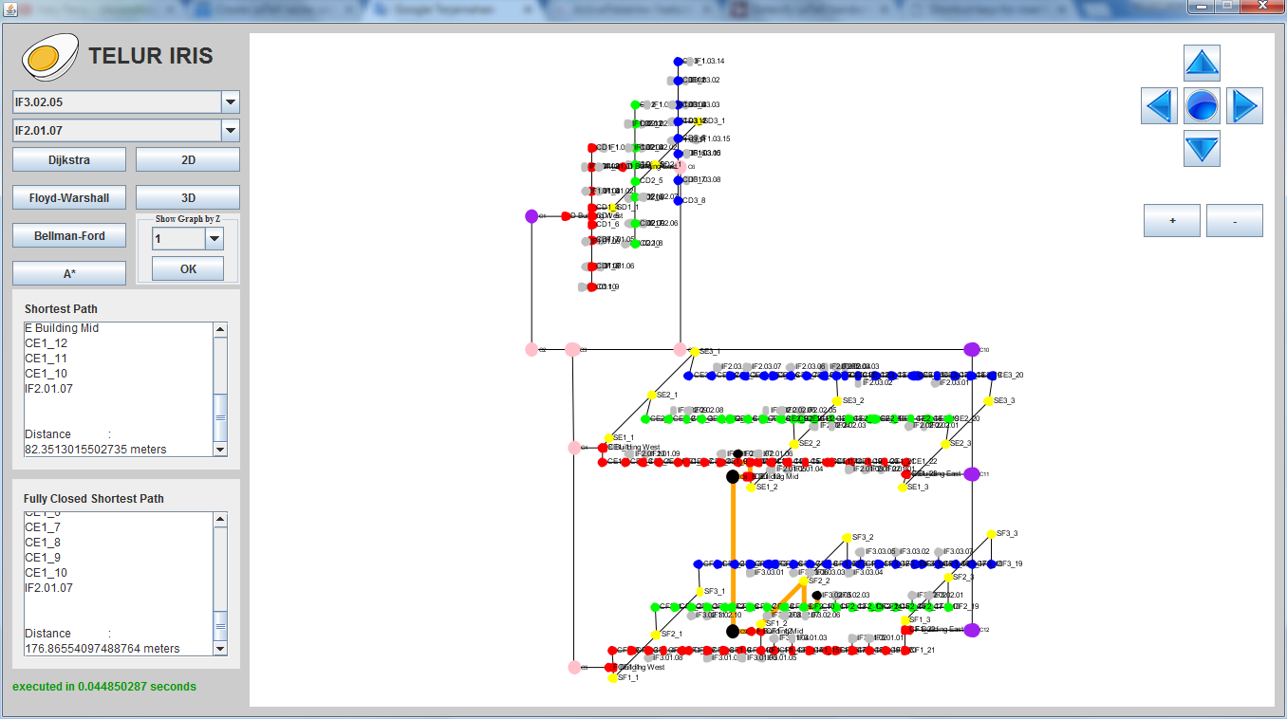
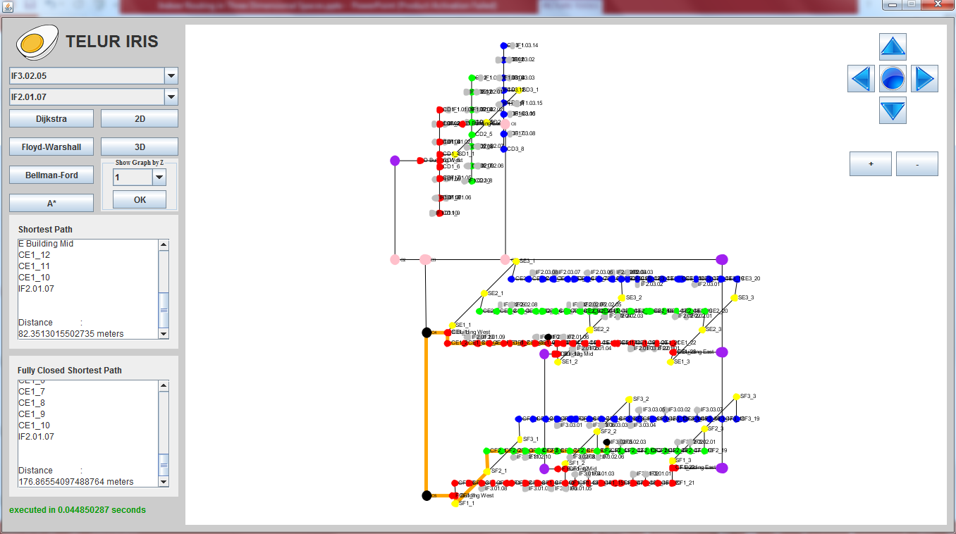
Shortest path vs close shortest path

Slide 11
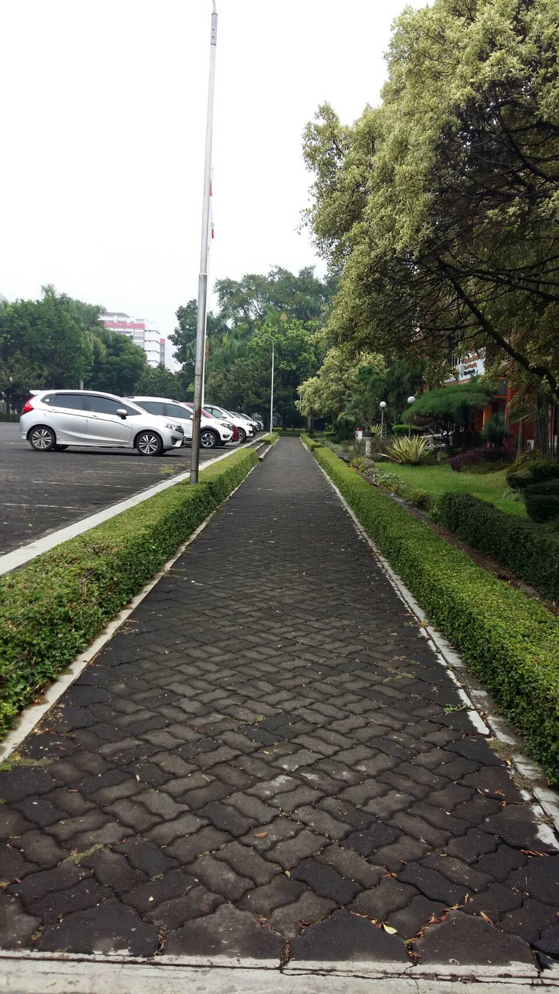
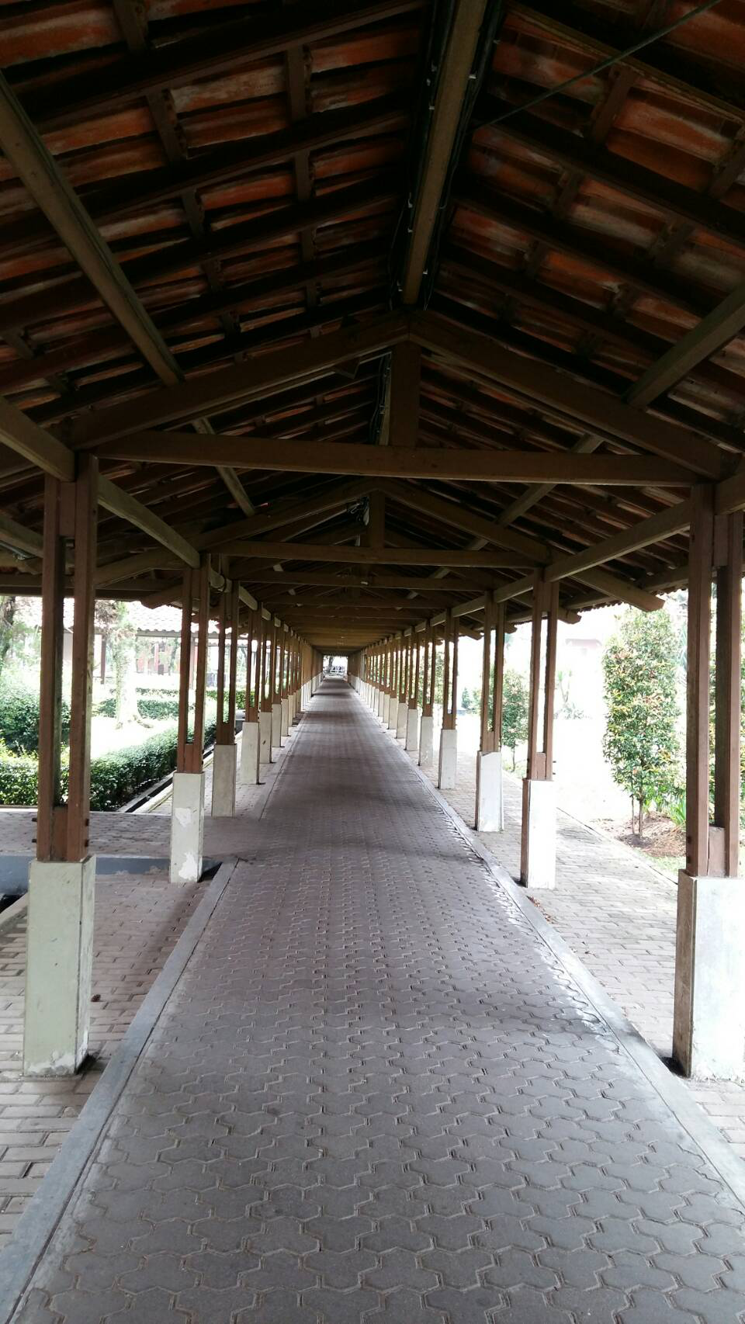
Shortest path vs close shortest path
✗

Slide 12
Shortest path vs close shortest path
✗
✗
✗
✗
✗
✗

Slide 13
PERFORMANCE TESTING

Slide 14
PERFORMANCE TESTING
WHY??

Slide 15
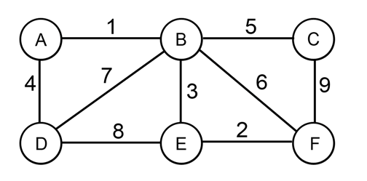
Algorithm testing : dijkstra
Source : A
Destination : F
Step | Visited | A | B | C | D | E | F
0 | A | 0 | ∞ | ∞ | ∞ | ∞ | ∞
1 | A | 0 | 1 | ∞ | 4 | ∞ | ∞
2 | A, B | 0 | 1 | 6 | 4 | 4 | 7
3 | A, B, E | 0 | 1 | 6 | 4 | 4 | 6
4 | A, B, E, D | 0 | 1 | 6 | 4 | 4 | 6
5 | A, B, E, D, F | 0 | 1 | 6 | 4 | 4 | 6
6 | A, B, E, D, F, C | 0 | 1 | 6 | 4 | 4 | 6

Slide 16
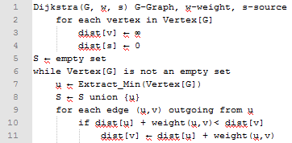
Algorithm testing : dijkstra
Time Complexity : O(V ²)
✓
Applicable?

Slide 17
Algorithm testing : floyd-warshall
Source : A
Destination : F
 | A | B | C | D | E | F
A | 0 | 1 | 6 | 4 | 4 | 6
B | 1 | 0 | 5 | 5 | 3 | 5
C | 6 | 5 | 0 | 10 | 8 | 9
D | 4 | 5 | 10 | 0 | 8 | 10
E | 4 | 3 | 8 | 8 | 0 | 2
F | 6 | 5 | 9 | 10 | 2 | 0
SHOW ITERATION

Slide 18
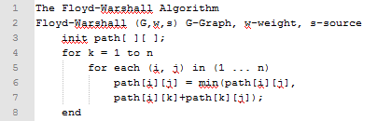
Algorithm testing : floyd-warshall
Time Complexity : O(V³)
✗
Applicable?

Slide 19
Algorithm testing : bellman-ford
Source : A
Destination : F
DESTINATION | A | B | C | D | E | F
 | 0 | 1 | 6 | 4 | 4 | 6

Slide 20
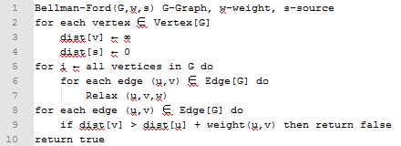
Algorithm testing : bellman-ford
Time Complexity : O(VE)
✗
Applicable?

Slide 21
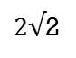
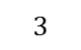
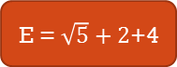
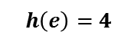
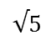
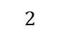

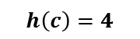
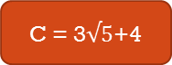
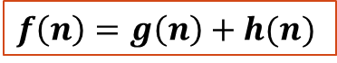
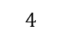

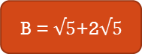
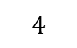
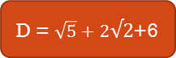

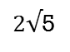
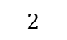
Algorithm testing : a*
Source : A
Destination : F
$$f\left(n\right)=g\left(n\right)+h(n)$$
C
$$h\left(c\right)=4$$
A
A
$$h\left(b\right)=2√5$$
$2√$5
B = $√5$+2$√5$
✓
D = 3+6
$$√5$$
B
$$4$$
$$3$$
$2√$5
C = 3$√5$+4
F = 3$√5$
E = $\sqrt{5}+2$+4
D = $\sqrt{5}+2√2$+6
$2√$2
✓
$$2$$
D
$$2$$
E
$$4$$
F
$$h\left(d\right)=6$$
$$h\left(e\right)=4$$
*It needs the coordinate information to get the value of $h\left(n\right)$

Slide 22
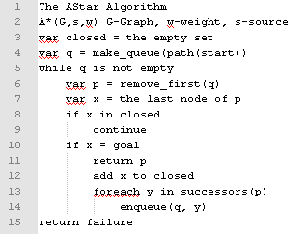
Algorithm testing : a*
Time Complexity : O(V )
✓
Applicable?

Slide 23
Shortest path algorithm
Algorithm | Time Complexity
Dijkstra ( with list ) | O(V ²)
Floyd-Warshall | O(V³)
Bellman-Ford | O(VE)
A* | O( V )

Slide 24
Distance Calculation Comparison (in meters)
No. | Scenario | Source | Destination | Shortest Path Distance from System (SPD_S) | Shortest Path Distance in Real (SPD_R) | Deviation (|SP_S - SP_R|)
1 | Same Building, Same Z | IF3.03.04 | IF3.03.05 | 8.661221996 | 6 | 2.661221996
2 |  | IF3.02.05 | IF3.02.01 | 34.78388051 | 34.7 | 0.083880508
3 |  | IF3.01.02 | IF3.01.03 | 21.56047226 | 21.7 | 0.139527743
4 | Same Building, Different Z | IF3.03.03 | IF3.02.05 | 38.7783564 | 34.1 | 4.6783564
5 |  | IF3.03.03 | IF3.01.05 | 41.18405404 | 35.4 | 5.784054043
6 |  | IF2.01.10 | IF2.02.09 | 36.66114963 | 31 | 5.661149626
7 | Different Building, same Z | IF2.01.05 | IF3.01.05 | 69.19729964 | 69.3 | 0.102700358
8 |  | IF2.01.10 | IF3.01.08 | 102.1953267 | 94 | 8.195326717
9 |  | IF2.01.10 | IF1.01.01 | 120.0752443 | 114.2 | 5.875244347
10 | Different Building, Different Z | IF3.01.05 | IF2.02.05 | 78.71397663 | 79.6 | 0.886023374
11 |  | IF2.02.01 | IF3.01.02 | 120.9040472 | 113.1 | 7.804047212
12 |  | IF3.03.04 | IF2.01.05 | 87.21359285 | 87.6 | 0.386407153
AVERAGE |  |  |  |  |  | 3.521495

Slide 25
Distance Calculation Comparison (in meters)
No. | Scenario | Source | Destination | Closed Path Distance from System (CP_S) | Closed Path Distance in Real(CP_R) | Deviation (CP_S-CP_R)
1 | Same Building, Same Z | IF3.03.04 | IF3.03.05 | 8.661221996 | 6 | 2.661221996
2 |  | IF3.02.05 | IF3.02.01 | 34.78388051 | 34.7 | 0.083880508
3 |  | IF3.01.02 | IF3.01.03 | 21.56047226 | 21.7 | 0.139527743
4 | Same Building, Different Z | IF3.03.03 | IF3.02.05 | 38.7783564 | 34.1 | 4.6783564
5 |  | IF3.03.03 | IF3.01.05 | 41.18405404 | 35.4 | 5.784054043
6 |  | IF2.01.10 | IF2.02.09 | 36.66114963 | 31 | 5.661149626
7 | Different Building, same Z | IF2.01.05 | IF3.01.05 | 168.010905 | 168.8 | 0.789095019
8 |  | IF2.01.10 | IF3.01.08 | 102.1953267 | 94 | 8.195326717
9 |  | IF2.01.10 | IF1.01.01 | 140.9867135 | 135.5 | 5.48671352
10 | Different Building, Different Z | IF3.01.05 | IF2.02.05 | 177.5121245 | 177.8 | 0.287875482
11 |  | IF2.02.01 | IF3.01.02 | 234.2925391 | 234.6 | 0.307460939
12 |  | IF3.03.04 | IF2.01.05 | 187.8782596 | 184.8 | 3.07825964
AVERAGE |  |  |  |  |  | 3.096076803

Slide 26
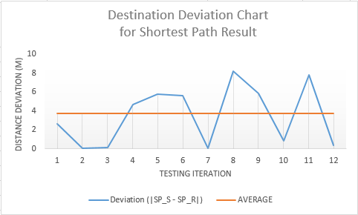
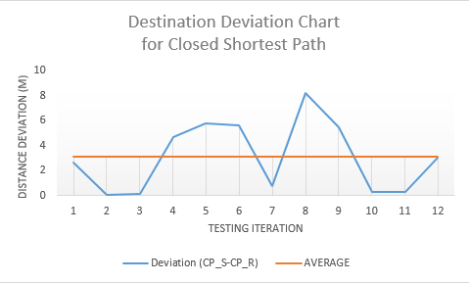
Distance deviation fluctuation
WHY??

Slide 27
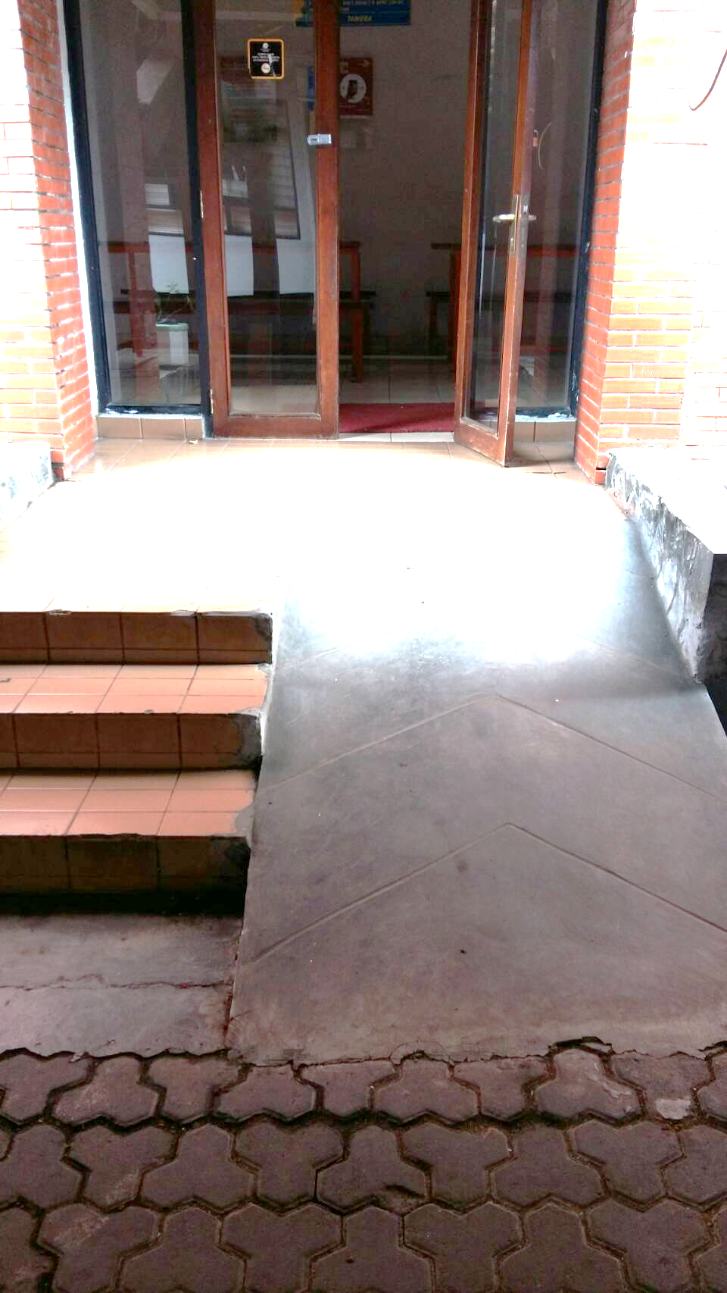
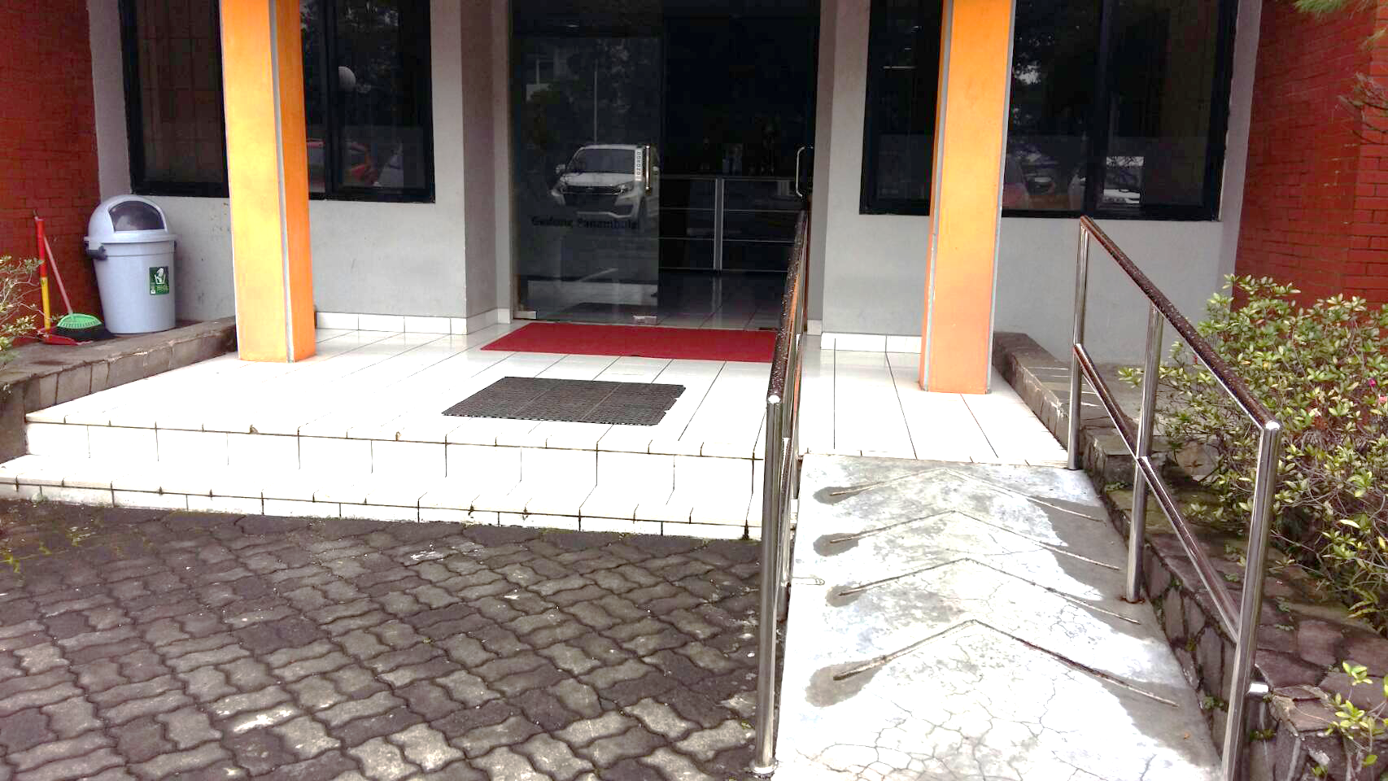
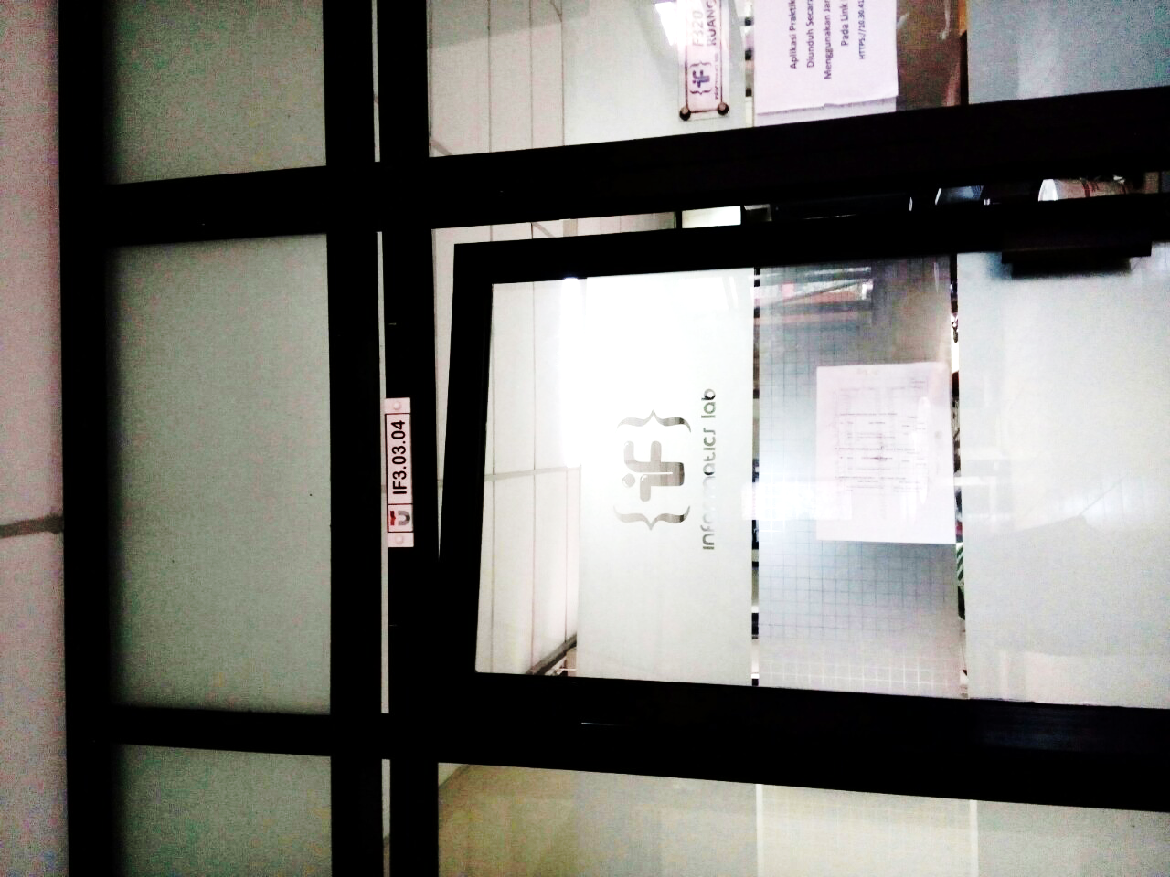
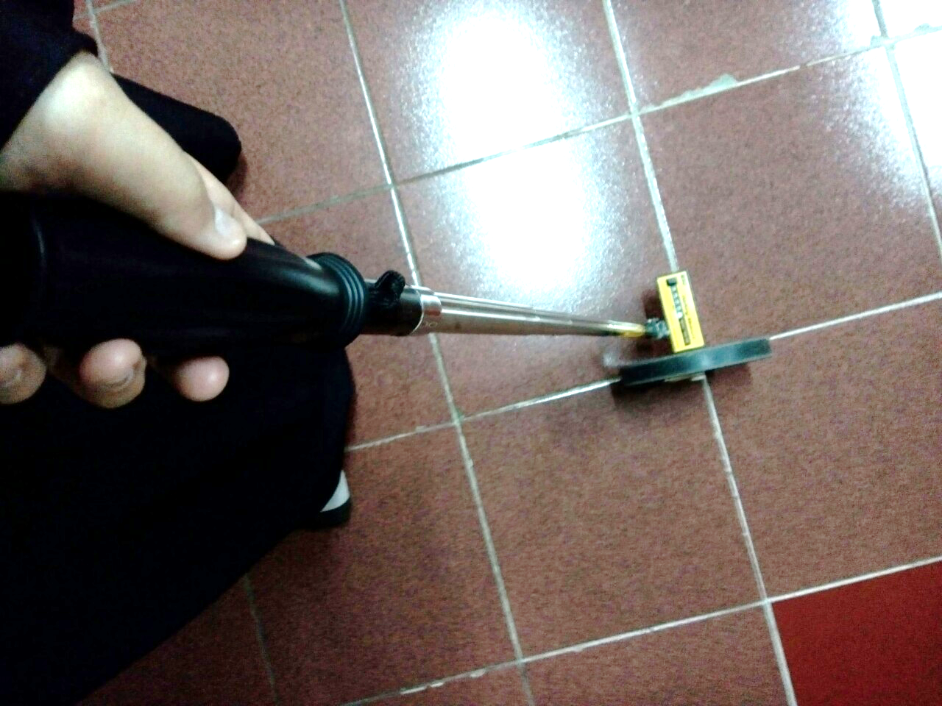
System vs real life
SYSTEM | REAL LIFE
Approximate Geotagging Nodes’ Location | Real Geolocation Node
Result of Calculation Process | Result of Measurement Process
Don’t care about low stair | Low stair will be measured
A*
Bellman-Ford
Floyd-Warshall
Dijkstra

Slide 28
conclution
Indoor Routing System could be implemented using three dimensional spaces.
The most suitable Shortest Path Algorithm to the three dimensional spaces data between Dijkstra, Floyd-Warshall, Bellman-Ford, and A* Algorithms is A* Algorithm that give the smallest value of execution time.
Floyd-Warshall and Bellman-Ford algorithms are not yet can be implemented in this case because Floyd–Warshall algorithm solves all pairs shortest distance, Bellman–Ford algorithm solves the single-source problem if edge weights may be negative, and both algorithms are not resulting the path but just the shortest distance value. Modification of these algorithms may could make it work.
This System still lack of resulting the exact distance after it compared with the distance in real life. There are a few reason of this lackness such as the process in getting the nodes’ coordinate is still not accurate enough and for buildings that have a bit length of stairs to connect to the outter space, it assumed as one heigh level, so there will be a little bit difference between the calculation result and the measurement result. In this case, the calculation result could be called as an APPROXIMATE DISTANCE.

Slide 29
Future work
Add some more dataset until the whole area of Telkom University. After that, it could be published in college's website so this system could be used for everyone.
Find another better way to get the exact longitude and latitude for the points. One of the examples is take a long walk from points to points and record the Longitude and Latitude coordinates.
It would be better if the graph could be viewed with the 3D blueprints of the buildings.
Try to implement hub labeling algorithm to get the shortest path.

Slide 30
Thankyou ☺

